Slide 1
Part of Speech Tagging
- Hrishikesh Gadkari
Notes:
The two papers mainly focus on part of speech tagging area.

Slide 2
Some Advances in Transformation-Based Part of Speech Tagging Eric Brill
Notes:
The second paper tells that the first approach is not sufficient for identifying sentence boundaries while tagging.

Slide 3
Introduction
Stochastic tagging
Trainable rule-based tagger
Relevant linguistic information with simple stochastic rules
Lexical relationship in tagging
Rule-based approach to tagging unknown words
Extended into a k-best tagger
Notes:
The stochastic tagging is high in accuracy in part of speech tagging but is poor in capturing linguistic information from sentences. Whereas a trainable rule-based tagger is same as accurate in part of speech tagging as well as capturing relevant linguistic information. A method for expressing lecal relationship in tagging. This tagger then extended to k-best tagger where multiple tags can be assigned to words.

Slide 4
Markov-Model Based Taggers
Tag sequence that maximizes
Prob(word|tag) * Prob(tag|previous n tags)
Notes:
Markov-model based taggers assign a sentence the tag sequence that maximizes Prob(word|tag)∗ Prob(tag|previous n tags). These probabilities can be estimated directly from a manually tagged corpus.

Slide 5
Stochastic Tagging
Avoid laborious manual rule construction
Linguistic information is only captured indirectly
Notes:
all recent work in developing automatically trained part of speech taggers has been on further exploring Markov-model based tagging.
Advantages: possibly capturing useful information that may not have been noticed by the human engineer
Disadvantages: stochastic taggers have the disadvantage that linguistic information is only captured indirectly, in large tables of statistics

Slide 6
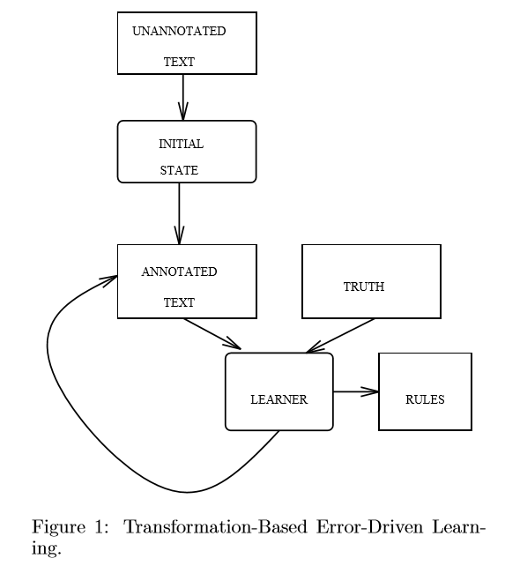
Transformation-Based Error-Driven Learning
Notes:
Learning process or train the tagger. The initial-state annotator can range in complexity from assigning random structure to assigning the output of a sophisticated manually created annotator. Once text has been passed through the initial-state annotator, it is then compared to the truth and transformations are learned that can be applied to the output of the initial state annotator to make it better resemble the truth. Once an ordered list of transformations is learned, new text can be annotated by ﬁrst applying the initial state annotator to it and then applying each of the learned transformations, in order.

Slide 7
An Earlier Transformation-Based Tagger
Initially assign most likely tag based on training corpus
Unknown word is tagged based on some features
Change tag a to b when:
The preceding/following word is tagged z
The word two before/after tagged z
One of the two/three preceding/following words is tagged z
The preceding word is tagged z and the following word is tagged w
The preceding/following word is tagged z and the word two before/after is tagged w
Example: change from noun to verb if previous word is a modal
Notes:
The most likely tag for unknown words is guessed based on a number of features, such as whether the word is capitalized, and what the last three letters of the word are.
where a,b,z and w are variables over the set of parts of speech

Slide 8
Lexicalizing the Tagger
Change tag a to tag b when:
The preceding/following word is w
The word two before/after is w
One of the two preceding/following words is w
The current word is w and the preceding/following word is x
The current word is w and the preceding/following word is tagged z
Example: change
From preposition to adverb if the word two positions to the right is “as”
From non-3rd person singular present verb to base form verb if one of the previous two words is “n’t”.
E.g. n’t is treated as a separate token, so don’t becomes do/VB-NON3rd-SING n’t/ADVERB
Notes:
The same is true of the earlier transformation-based tagger, where transformation templates did not make reference to words. where w and x are variables over all words in the training corpus, and z is a variable over all parts of speech.

Slide 9
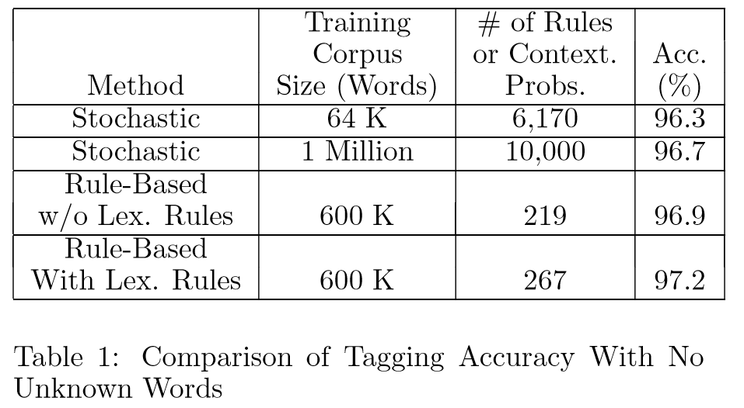
Comparison of Tagging Accuracy With No Unknown Words
Notes:
Training corpus is nothing but vocabulary. When training contextual probabilities on 1 million words, an accuracy of 96.7% was achieved. Accuracy dropped to 96.3% when contextual probabilities were trained on 64,000 words. We trained the transformation-based tagger on 600,000 words from the same corpus, making the same closed vocabulary assumption,9 and achieved an accuracy of 97.2% on a separate 150,000 word test set. The transformation-based learner achieved better performance, despite the fact that contextual information was captured in only 267 simple nonstochastic rules, as opposed to 10,000 contextual probabilities that were learned by the stochastic tagger. To see whether lexicalized transformations were contributing to the accuracy rate, we ran the exact same test using the tagger trained using the earlier transformation template set, which contained no transformations making reference to words. Accuracy of that tagger was 96.9%

Slide 10
Unknown Words
Change the tag of an unknown word (from X) to Y if:
Deleting the preﬁx x, |x| <= 4, results in a word (x is any string of length 1 to 4)
The ﬁrst (1,2,3,4) characters of the word are x
Deleting the suﬃx x, |x| <= 4, results in a word
The last (1,2,3,4) characters of the word are x
Adding the character string x as a suﬃx results in a word (|x| <= 4)
Adding the character string x as a preﬁx results in a word (|x| <= 4)
Word W ever appears immediately to the left (right) of the word
Character Z appears in the word
Notes:
with the original transformation-based tagger was its relatively low accuracy at tagging unknown words. The new contextual rules.

Slide 11
Unknown Words Learning
Change tag:
From common noun to plural common noun if the word has suﬃx “–s”
From common noun to number if the word has character “.”
From common noun to adjective if the word has character “-”
From common noun to past participle verb if the word has suﬃx “–ed”
From common noun to gerund or present participle verb if the word has suﬃx “–ing”
To adjective if adding the suﬃx “-ly” results in a word
To adverb if the word has suﬃx “–ly”
From common noun to number if the word “$” ever appears immediately to the left
From common noun to adjective if the word has suﬃx “–al”
From noun to base form verb if the word “would” ever appears immediately to the left
Notes:
An unannotated text can be used to check the conditions in all of the above transformation templates. Annotated text is necessary in training to measure the eﬀect of transformations on tagging accuracy. Below are the ﬁrst 10 transformation learned for tagging unknown words

Slide 12
K-Best Tags
Modify “change” to “add” in the transformation templates
Notes:
When allowing more than one tag per word, there is a trade-oﬀ between accuracy and the average number of tags for each word. Ideally, we would like to achieve as large an increase in accuracy with as few extra tags as possible. Therefore, in training we ﬁnd transformations that maximize precisely this function.

Slide 13
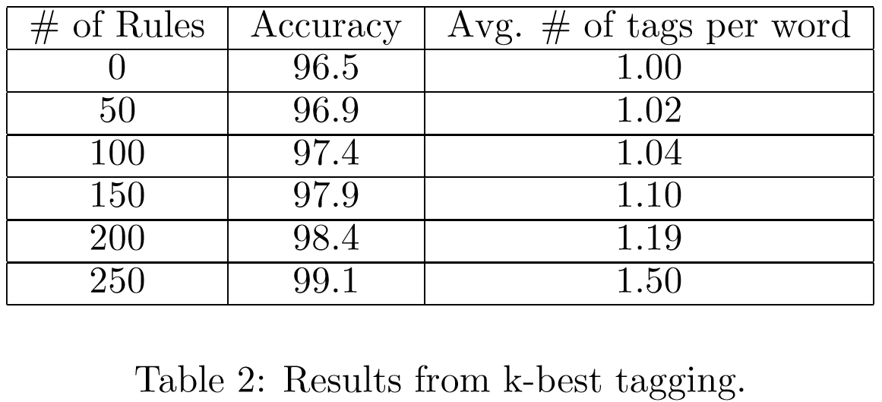
K-Best Tagging Results

Slide 14
A Maximum Entropy Approach to Identifying Sentence Boundaries
Jeffrey C. Reynar and Adwait Ratnaparkhi

Slide 15
Introduction
Mainly freely available natural language processing tools require their input to be divided into sentences, but make no mention of how to accomplish this
Punctuation marks, such as ., ?, and ! Might be ambiguous.
Issues with abbreviations:
Example: The president lives in Washington, D.C.

Slide 16
Previous Work
To disambiguate sentence boundaries they use
A decision tree (99.8% accuracy on Brown corpus)
or
A neural network (98.5% accuracy on WSJ corpus)

Slide 17
Approach
Potential sentence boundary (., ? And !)
Contextual Information
The Prefix
The Suffix
The presence of particular characters in the Prefix or Suffix
Whether the Candidate is an honorific (e.g. Ms., Dr., Gen.)
Whether the Candidate is a corporate designator (e.g. Corp., S.p.A., L.L.C.)
Features of the word left/right of the Candidate
List of abbreviations

Slide 18
Maximum Entropy
The model used here for sentence-boundary detection is based on the maximum entropy model used for POS tagging
Estimating a joint probability distribution of the token and it’s surrounding context and thus maximizing the entropy
Notes:
Used the model on WSJ corpus. we estimate a joint probability distribution p of the token and it’s surrounding context. All experiments use a simple decision rule to elas- si[y each potential sentence boundary: a potential sentence boundary is an actual sentence boundary if and only if p(yeslc ) > .5

Slide 19
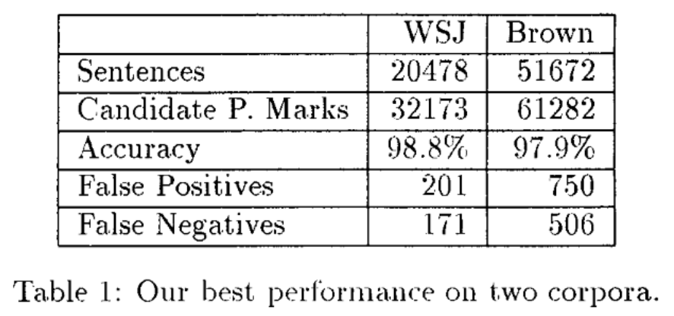
System Performance

